Slide 1



IGNITE
Pitch Deck
Milestone 1

Slide 2



Who we are
AquaSmart
Name of your Venture:………………………..
Why ?
Explain why do you want to pursue this Business Idea.
We chose AquaSmart because water wastage is a major problem in households. Many people waste water due to leaking taps, overflowing tanks, and careless usage. Most users are not aware of how much water they consume daily. As engineering students, we wanted to create a simple and effective solution. This idea helps in saving water and promoting awareness.
What ?
Provide a brief on what does your venture do.
AquaSmart is a smart system that monitors water usage in homes. It uses a water flow sensor to measure consumption. The system alerts users when usage exceeds a limit. It can also detect leakages in pipelines. Overall, it helps reduce water wastage and improve efficiency.
How ?
Explain how your venture solves the problem and make its revenue.
AquaSmart works by installing a water flow sensor in pipelines. The sensor sends data to a microcontroller for processing. When excess usage or leakage is detected, alerts are given. This helps users take quick action to save water. The product can be sold at low cost with additional revenue from services.

Slide 3

Problem/Opportunity
CONTEXT When does the problem occur? Water wastage occurs during daily activities (bathing, washing, cleaning). Common in cases of running taps and tank overflows Leakage in pipelines causes continuous loss No real-time monitoring systems in most homes Users lack awareness of consumption levels. Occurs in both urban and rural households Problem is frequent and mostly unnoticed | PROBLEM What is the root cause of the problem? Absence of water usage monitoring systems . No real-time alerts for overuse or leakage . Human negligence (forgetting to close taps). Faulty plumbing increases wastage Lack of data-driven decision making No automation in existing systems Results in resource depletion and cost increase | ALTERNATIVES What do customers do now to ﬁx the problem? Manual control of water usage (closing taps after use) Float valve systems to prevent tank overflow Periodic plumbing checks for leak detection Use of basic timers for water usage control Awareness campaigns promoting water conservation Visual monitoring of tanks and pipelines Simple mechanical regulators in some systems
CUSTOMERS Who has the problem most often? Household users (urban and rural) Apartment residents with shared water systems Independent house owners Families, students, working professionals Property owners managing water bills Housing societies and small buildings Broad market: almost every household | EMOTIONAL IMPACT How does the customer feel? Guilt over wasting natural resources Stress due to high water bills Fear in water-scarce regions | ALTERNATIVE SHORTCOMINGS What are the disadvantages of the alternatives? Fully dependent on human attention → prone to errors No real-time monitoring or usage tracking Cannot detect small or hidden leakages effectively No automated alerts or notifications Float valves lack precision and can fail No data analytics for optimization of usage Not scalable for modern smart homes
 | QUANTIFIABLE IMPACT What is the measurable impact (include units)? Leak: ~10–20 liters/day loss per tap Tank overflow: hundreds of liters wasted Increased monthly water expenses Contributes to regional water scarcity
This table helps you define the problem and existing market gaps.

Slide 4
Problem Interviews And Surveys Results
How many customers did you interview?
20
What was the interview mode?
offline
How many of them agree this is a problem and wants a solution?
15
How many of them said they don't need a new solution?
5

Slide 5
Market Size Estimation
TAM
SAM
SOM
How to calculate market size?
Start with Total Addressable market-In India, there are around 30 crore houses that use water. All these houses can use AquaSmart → this is our total market.
2. We are mainly targeting city and town houses where people use smart devices. This is about 10 crore houses
3. Currently, basic water level indicators and manual monitoring systems are used, but there are very few smart automated solutions. As awareness of water conservation increases, adoption of smart systems is expected to grow. Based on similar smart home technologies:
Short term (first 3–5 years): 2–5% of SAM
Long term (next 5–10 years): 10–15% of SAM
Conclusion – Expected penetration rate is 2–5% initially, increasing as people trust and adopt smart water-saving technology.
4. If AquaSmart captures even 2–5% of the target market (10 crore households), that equals 20–50lakhhouseholds. . Assuming an average price of ₹1000 per system, the estimated market size is ₹200–₹500 crore in the initial 3–5 years.
.
Sources: ……

Slide 6
Customer Persona
Responsilbe
Environment conscious
Tech-friendly
Motivations
Ethos : He is a responsible and practical individual who values stability, minimizes waste, and prefers reliable cost-effective solutions to support his family’s long-term well-being.
Goals
-save water in daily life
-Reduce water bills
-Avoid tank overflow and leakage
-Use smart technology at home
Age: 35
Occupation: Family Business
Location: Bengaluru
Frustrations
-water wastage without knowing
-tank overflow problems
-high water bills
-No proper system to track water savage
Personality
Bio
A middle-class house owner living in a city. Uses water daily but is concerned about wastage and increasing bills. Interested in simple and affordable smart solutions to manage water efficiently.
Notes:
Time: 7 mins
Get students to brainstorm on the customer persona and VPC

Slide 7
Value Proposition Canvas
.
What do you offer that makes the customers happy?
Real-time tracking of water usage.
Reduces water wastage significantly
Saves money on water bills
Increases awareness of consumption
I would LOVE it if:
Efficent and controlled water usage
Real time monitoring and alerts
Eco-friendly lifestyle
Reliable and long-term solution
What is the product or service that you are offering?
Smart water monitoring system
Uses water flow sensors + microcontroller
Tracks real time water consumption
Provides alerts for overuse and leak detection
Optional automatic water shut off system
I would WANT:
Use water for daily activities
Manage household water consumption
Avoid wastage and reduce bills
Monitor water tank levels
Fix Leaks and maintain plumbing
GAIN CREATORS
FIT
GAINS
PRODUCT/
SERVICE
JOBS
PAIN KILLERS
PAINS
Which features of your offering relieve the customer's pains?
Detects leaks instantly
Alerts users
Provides usage data
Prevents tank overflow automatically.
Reduces stress related to high bills
I would HATE it if:
Water wastage due to leaks and overflow
High water bills
Lack of monitoring systems
Manual effort and forgetfulness
Sudden water shortages

Slide 8
Solution
Describe your Solution:
We offer a smart water management system called AquaSmart that monitors and controls water usage in households.
The details of our offering consist of:
Water flow sensor to measure real-time water consumption
Microcontroller-based system for data processing and alert generation
Alert/notification system (buzzer or mobile app) for leak detection and overuse
List the Benefits of Your solutions
1. Reduces water wastage through real-time monitoring and alerts
2. Saves money by controlling unnecessary water usage
3. Provides a smart, automated, and user-friendly solution for households
Notes:
Evaluation Criteria for slides 8 and 9
Check the following on the correctness of VPC: a. Have you identified the correct pains & gains; pain relievers & gain creators (2 marks) b. Have you identified the correct Jobs-to-be-done? (1 mark) c. Are the pain relievers addressing the customer pains? (1 mark) d. Have you identified the right value proposition so that the solution makes the customer's life better? (1 mark)

Slide 9

Competition Analysis
Benefits | Competitor 1 (Water Level Indicator) | Competitor 2 (Float valve System) | Competitor 3 (Smart Water Meter) | Competitor 4 (Xylem Smart Solutions) | Your Venture
Product | Tank level monitoring | Overflow prevention | Water usage tracking | Advanced water management system | Smart water monitoring & alerts
Price | Low | Low | High | High | Affordable
Branding channels | Local hardware stores | Plumbing suppliers | Online & dealers | Smart home retailers | Online, app & local dealers
Packaging | Basic | Basic | Premium | Enterprise-grade systems | Compact & user-friendly
Market reviews | Useful but limited | Reliable but limited | Good but expensive | Highly effective but costly | Smart, affordable & feature-rich
UVP | Shows water level only | Stops overflow only | Usage tracking only | Large-scale smart water infrastructure | Detects leaks, overflow & limit exceedance with mobile alerts
Add more as required | No alerts | No alerts | Limited notifications | Advanced analytics & monitoring | Cloud storage, app dashboard & real-time notifications

Slide 10
Lean Canvas
PROBLEM
Water wastage in households
Tank overflow
Pipeline leakages
High water bills
No monitoring system
EXISTING ALTERNATIVES
Float valves
Manual monitoring
Timers
Water level indicators
SOLUTION
A smart IoT-based water management system that monitors water usage, detects leakage, and alerts users instantly.
UNIQUE VALUE PROPOSITION
"Monitor water. Detect leaks. Prevent overflow. Save every drop.“
HIGH-LEVEL CONCEPT
AquaSmart acts like a smart assistant for household water management.
UNFAIR ADVANTAGE
Low-cost solution
Easy installation
User-friendly design
Real-time monitoring
Focus on Indian households
CUSTOMER SEGMENTS
Urban households
Apartment residents
Independent house owners
Small buildings
Water-conscious users
EARLY ADOPTERS
Tech-friendly families
Smart home users
Apartment associations
Environment-conscious households
Business Model (Explain with a process diagram)
AquaSmart generates revenue by selling smart water monitoring devices to households and residential buildings. Customers purchase the system, which is installed in their water pipeline network. The system continuously monitors water consumption and provides alerts for leakages, overuse, and tank overflow. Revenue is earned through device sales, installation charges, maintenance services, and future subscription-based monitoring features.
Customer
↓
Purchase AquaSmart System
↓
Installation in Home
↓
Water Usage Monitoring
↓
Leakage / Overflow Detection
↓
Real-Time Alerts to User
↓
Reduced Water Wastage & Bills
↓
Customer Satisfaction
↓
Revenue through Product Sales,
Installation & Maintenance Services
KEY METRICS
Water saved per household
Number of leak detections
Monthly active users
Reduction in water bills
CHANNELS
Online marketing
Social media
Hardware stores
Apartment partnerships
College exhibitions
COST STRUCTURE
Sensors and electronics
Manufacturing
Marketing
Packaging
Maintenance support
REVENUE STREAMS
Product sales
Installation fees
Maintenance subscription
Future app subscriptions

Slide 11

MVP
Provide Full product/service description
Insert a picture of the prototype
Provide video link of the working prototype, if any
Share screenshots of website ( Landing page, testimony etc.,). If the venture is in any online business, it must definitely showcase a functional website.
Share website link (If the venture is in any online business, it must definitely showcase a functional website.)
Share App link
Description of how the product will work and steps the customer will follow
Any other information
The slide helps to see your vision in action with a clear demonstration

Slide 12
MVP Validation
What is your MVP
Conclusion:
Test Details:
Persevere
Pivot
How long will we test this MVP?
Not conclusive
Who is our target audience for the test? How many of them?
How will we get to that audience?
Results of Test:
Realizations / Insights:
Did enough customers buy? Why or why not?
Did customers pay the price we expected? Why or why not?
Did customers come back to our product or show interest in doing so? Why or why not?
Next Steps:
Did customers recommend our product to others or evangelize about it? Why or why not?
Notes:
Evaluation Criteria for slides 12 to 14
Check the following on MVP? 1. Does it look credible and showcasable? Add a picture/video of the MVP? (3 marks) 2. Have you validated the product benefits and the price with real customers? Add the MVP interview records in a Google drive and add to the PPT. (1 + 1 marks)

Slide 13
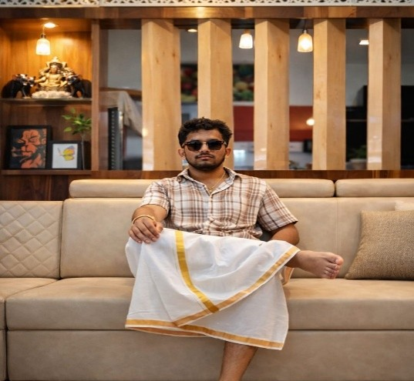
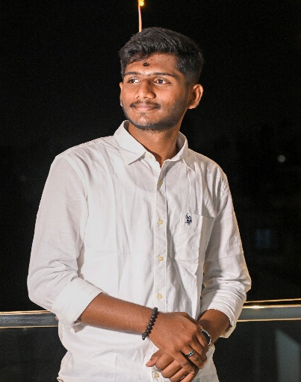
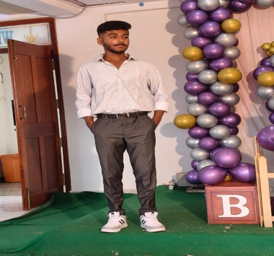
Team Composition
JAYANTH S
ADITHYA V
DARSHAN GOWDA M
What makes us a good team to solve the problem we chose?
Our team has a good combination of skills ,teamwork and
Communication, which helps us to solve problems effectively
CEO
Technical head
Finance and marketing Head
Key Strengths and abilities
-Leadership and decision making
-Problem-solving ability
-Managing team and Planning
Key Strengths and abilities
-Technical knowledge
-Innovation and creativity
-ensuring system works properly
Key Strengths and abilities
-Understanding customer needs
-Pricing and Profit skills
-selling and communication skills

Slide 14
Thank You!

